Slide 1



Investigating geothermal heat resources of legacy mine workings: Why are some mine waters hotter than others?
Mylene Receveur
Andrew Fraser-Harris, Stuart Gilfillan, Christopher McDermott, Ian Watson
Notes:
New kind of underground geothermal reservoir - enhanced by humain → mines
Spread across UK but different temperature
Aim of phd = understanding why

Slide 2
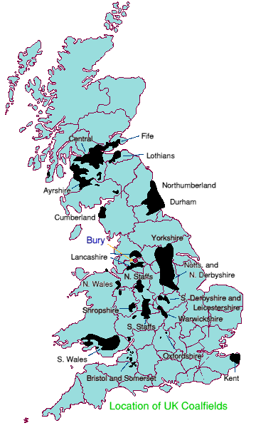
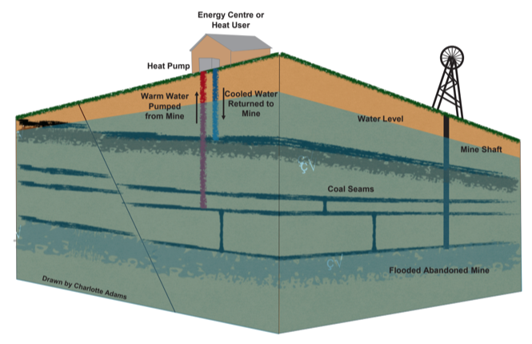
Study background
Introduction
Methods
Objectives
Conclusion
Summary
Co-location with population density
Existing 12-20 °C resource
Open-loop GSHP systems
Seasonal production
Existing case study:
UK (Shettleston, Dawdon)
The Netherlands (Heerlen)
Spain, Canada, USA, Poland …
Schematic diagram of a mine water heat pump system (Adams et al. 2019)
Notes:
Minewater geothermal has massive potential:
Co-location with population density and regeneration of mining communities: 9% of UK population located above abandonned coal mines
Making use of existing mine legacy (and potential liability for the CA) = Mine closed but could still be mined for heat, as flooded
Can be used for space / hot water heating
How does this work?
Warm water can be extracted at high rates from enhanced-permeability reservoirs because large voids.
In the UK, those voids (mine shafts, tunnels, workings) are in the coal measures (shallow early mining) and down to 800 m depth (LCR, deep mining)
GSHP used to extract heat from the ground or from the water using open-loop systems.
Injection/production of cold/hot water can be reversed seasonally. Proven to increase the system lifetime.
It has been shown to work both in the UK and elsewhere
At Heerlen, abandoned mines are used to deliver space heating and cooling to around 200,000 m2 of mixed use new and retrofit buildings via a 7-km-long heat network (Verhoeven et al., Energy Procedia 2014).
In Shettleston, where at least 6 seams have been mined, the water is heated to 55°C through a heat exchanger, to provide heat to 16 dwellings. In Lumphinnans, at least 11 seams belonging to the Lower Carboniferous Limestone Coal Group have been mined (including the uppermost Lochgelly Black Band Ironstone, the Seven Foot Seam, the Kelty Main, the Jersey or Diamond Seam and the Swallowdrum (Burke 1999)).

Slide 3
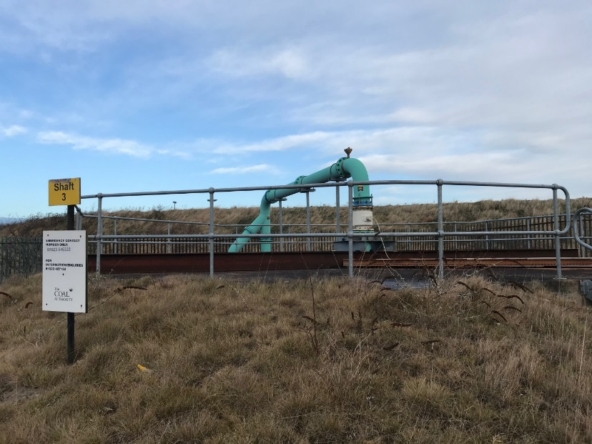
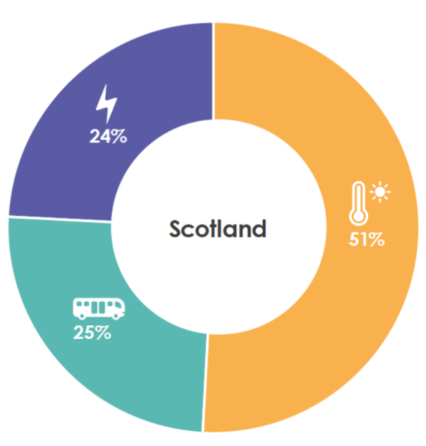
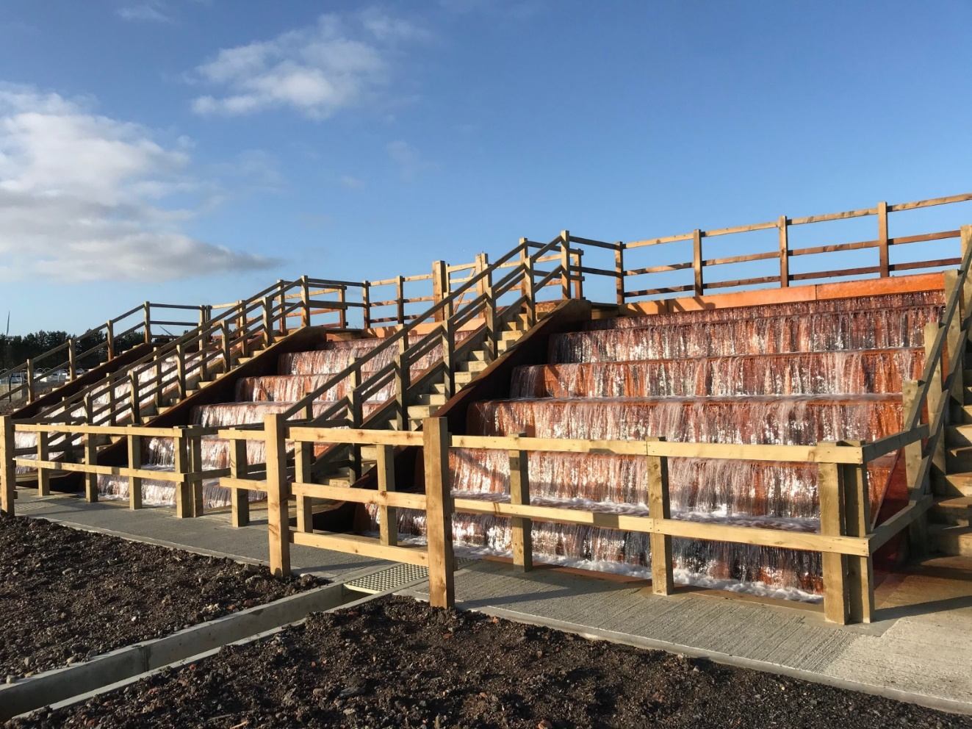
Study background
Introduction
Methods
Objectives
Conclusion
Summary
Bates pumping shaft 3
Coal Authority liable for UK mines
7% of Scotland’s heat demand (Todd et al., 2019*)
Can contribute to decarbonization of residential heat
Cascade Lynemouth
*DOI: 10.1144/sjg2018-028
Notes:
Coal authority interest – finance pumping fees they are responsible for (avoid mine-water surface contamination)
How much primary energy usage goes to heating in the UK = 50 %
Can contribute to decarbonization of residential heat

Slide 4
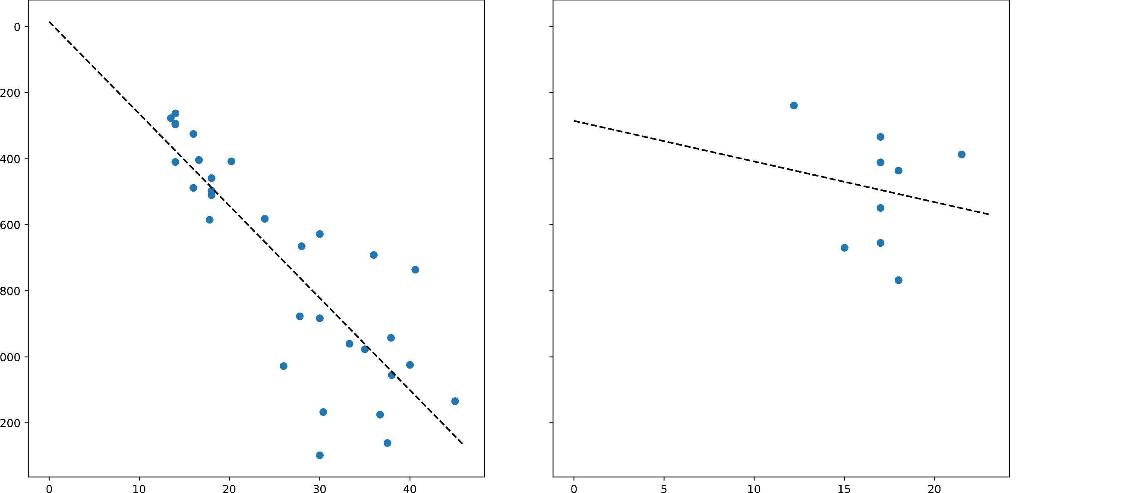
Research question
Introduction
Methods
Objectives
Conclusion
Summary
Bottom Hole temperature Mine-water temperature
T= 8 + 0.03 z
???
Depth
(Burley, 1984; Gillespie, 2013)
Temperature Temperature
Where does the heat come from ?
What is the extent of the area impacted by water / heat extraction ?
How fast is it recharged ?
→ Necessary to evaluate the geothermal potential of mine & sustainability.
→ Numerical modeling
Notes:
Mines are incredibly complex systems and in the UK there is a no clear relationship between MWT and depth
Past study has shown lack of correlation between temperature and depth (Gillespie et al., 2013)
Pumping/resource is here BUT poor understanding of the origin of heat in mines
= Issue to evaluate their geothermal potential as injection / recharge of groundwater can induce GW flux of colder water
Raises questions such as why?!
What are the main controls on mine water temperature ?
How/at which rate is minewater heat recharged?
What is the sustainability of heat supply?
What is the are impacted/connectivity with other potential surface users?
These are some of the questions I am hoping to answer.

Slide 5
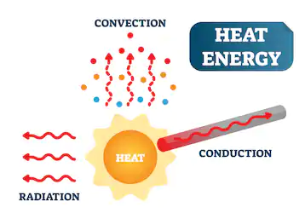
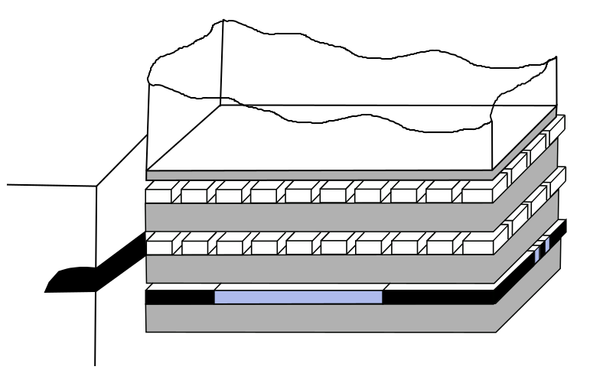
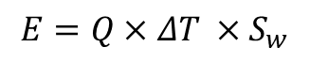
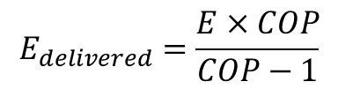
Objective 3 Objective 2 Objective 1
Introduction
Methods
Objectives
Conclusion
Summary
Determine the main heat sources and heat transfer mechanisms in flooded coal mines.
What is the heat recovery rate of water?
Assess the important geometrical features for mine modelling.
How can we simplify mine plans to build representative models?
Evaluate the footprint area of heat extraction
What is the geothermal potential of mines?
Can a sustainable heat extraction rate be maintained?
$$E=Q×ΔT ×S_{w}$$
$$E_{delivered}=\frac{E×COP}{COP−1}$$
Notes:
No modelling strategies have emerged yet.
Models have to deal with lack of data and lots of uncertainties
Want to know about the heat transfers / recharge mechanisms at the scale of the mine / several mines
Necessity to simplify systems
Thus:
Need to understand the relative contribution of different heat sources – the main control mechanisms on MW temperature
Complex mines (different mining geometries, residual mining voids, open shafts and roadway VS working panels / P&S)
→ Does the geometry of mine workings / interconnections matter ?
→ Can digitalized GIS shapefile be used in models or are more complex geometries required?
Can we extract heat required for domestic heating at a sustainable rate – what is the areal extent required = what area will be cooled ? At which rate heat would recover ?

Slide 6
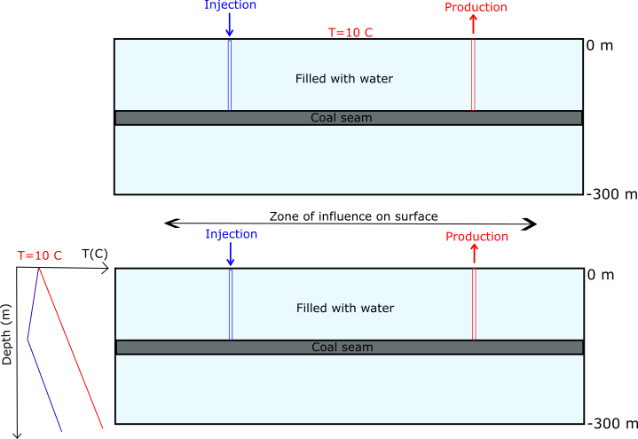
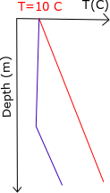
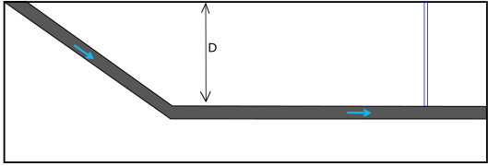
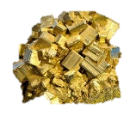
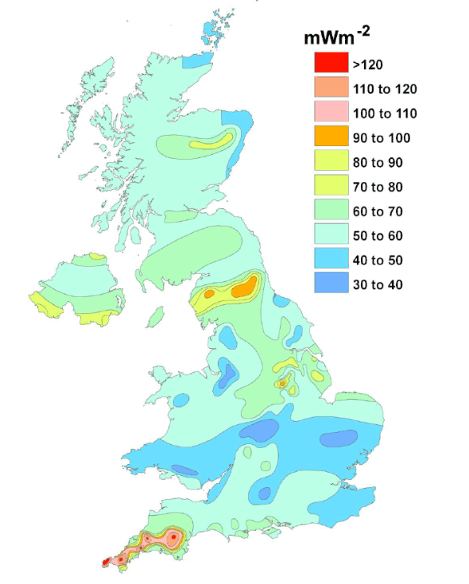
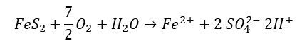
Introduction
Methods
Objectives
Conclusion
Summary
Conceptual models
Potential source of heat
natural heat flow
local heat generation
solar influx
groundwater flow (source of water?)
rainfall
geological structure
Solar flux
Rainfall
$${FeS}_{2}+\frac{7}{2}O_{2}+H_{2}O→{Fe}^{2+}+2 {SO}_{4}^{2−} {2H}^{+}$$
Notes:
First step: 2D models based on conceptual/simple mine geometry
Test several heat inputs:
Local heat generation : radiactive decay, pyrite oxidation
Groundwater flow = convective flux
geological structure: geological formation with specific material, thermal and hydraulic properties; geological disturbances (i.e. faults)
Still uncertainties about the origin of recharge water

Slide 7
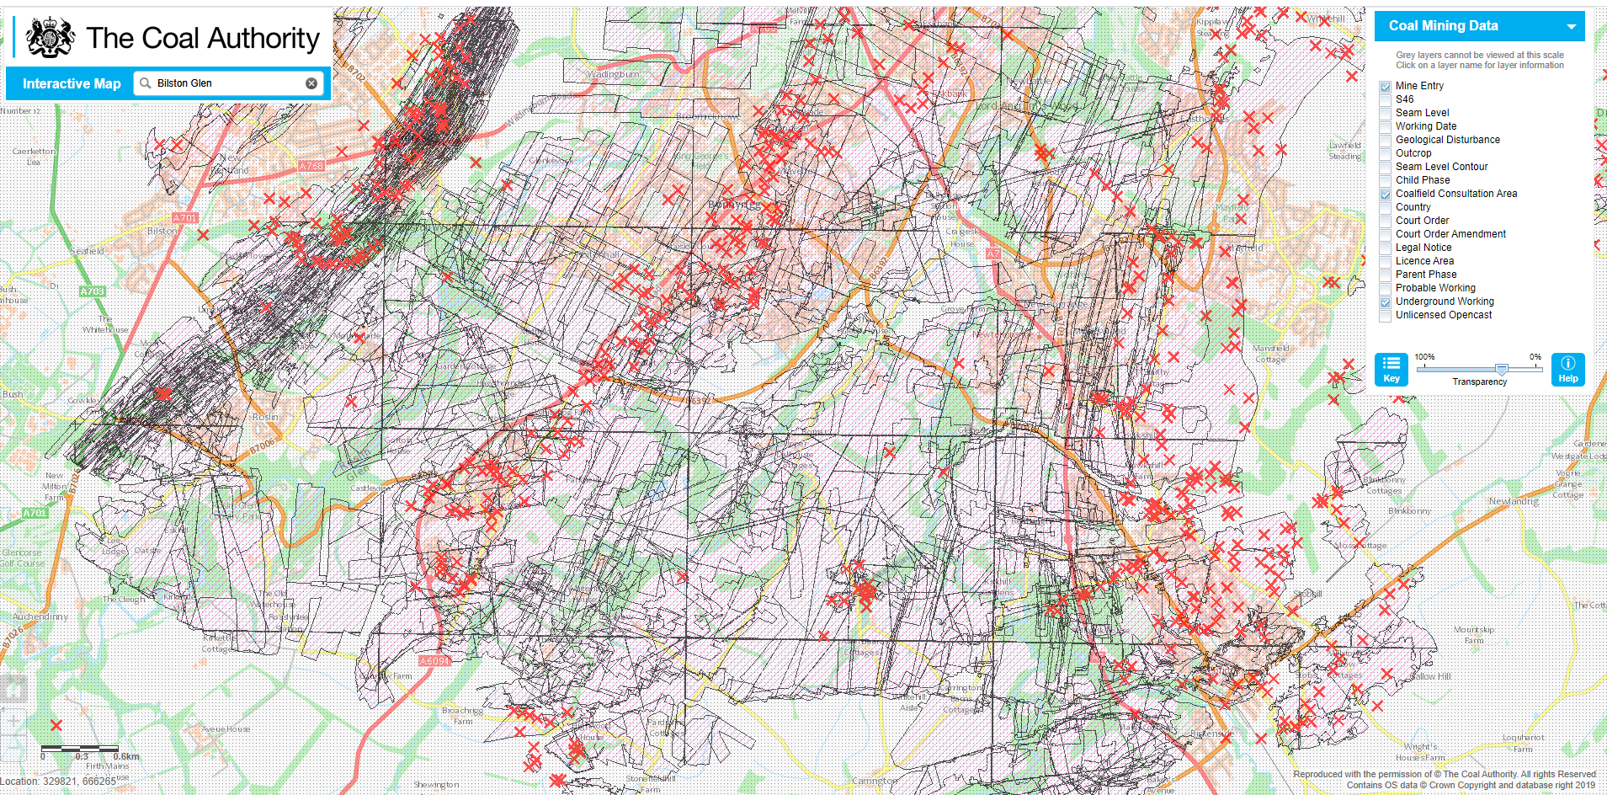
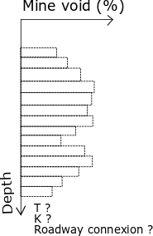
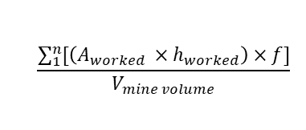
Introduction
Methods
Objectives
Conclusion
Summary
Mine geometry simplification
Digitalized GIS shapefile of mine workings
Roadway, shaft & mine interconnections
Statistical distribution of mine workings with depth
$$\frac{\sum_{1}^{n}{[\left(A_{worked} ×h_{worked}\right)}×f]}{V_{mine volume}}$$
Map of the digitalized mine workings in Bilston Glen area (Scotland).
Source: https://mapapps2.bgs.ac.uk/coalauthority/home.html
Notes:
First step: 2D models based on conceptual/simple mine geometry
Test several heat inputs:
- Local heat generation : radiactive decay, pyrite oxidation
- Groundwater flow = convective flux
geological structure: geological formation with specific material, thermal and hydraulic properties; geological disturbances (i.e. faults)
Still uncertainties about the origin of recharge water

Slide 8
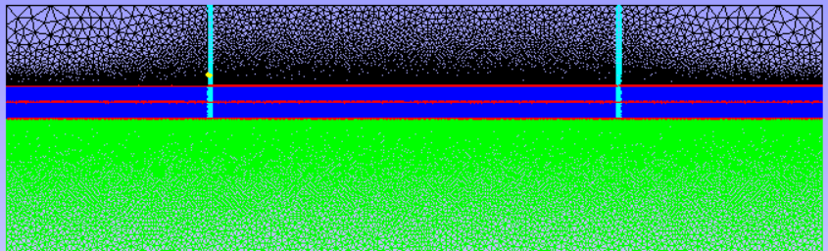
Introduction
Methods
Objectives
Conclusion
Summary
Numerical simulation using OpenGeosys
Petrophysical properties (Material Group)
Hydraulic / thermal properties
Initial / boundary conditions
Source terms
Sensitivity analysis on model parameters
Production Temperature ?
0
-100 m
-300m
Notes:
Each will be solved numerically using OGS: open source FEM software
Definition of BC / Source term for each situation mentionned before
Sensitivity analysis on geometrical, technical or numerical parameters:
Simulation of cold water injection/recharge will allow determining, through sensitivity analysis, the parameters the more likely to influence mine water temperature (relative contrinution of each).

Slide 9
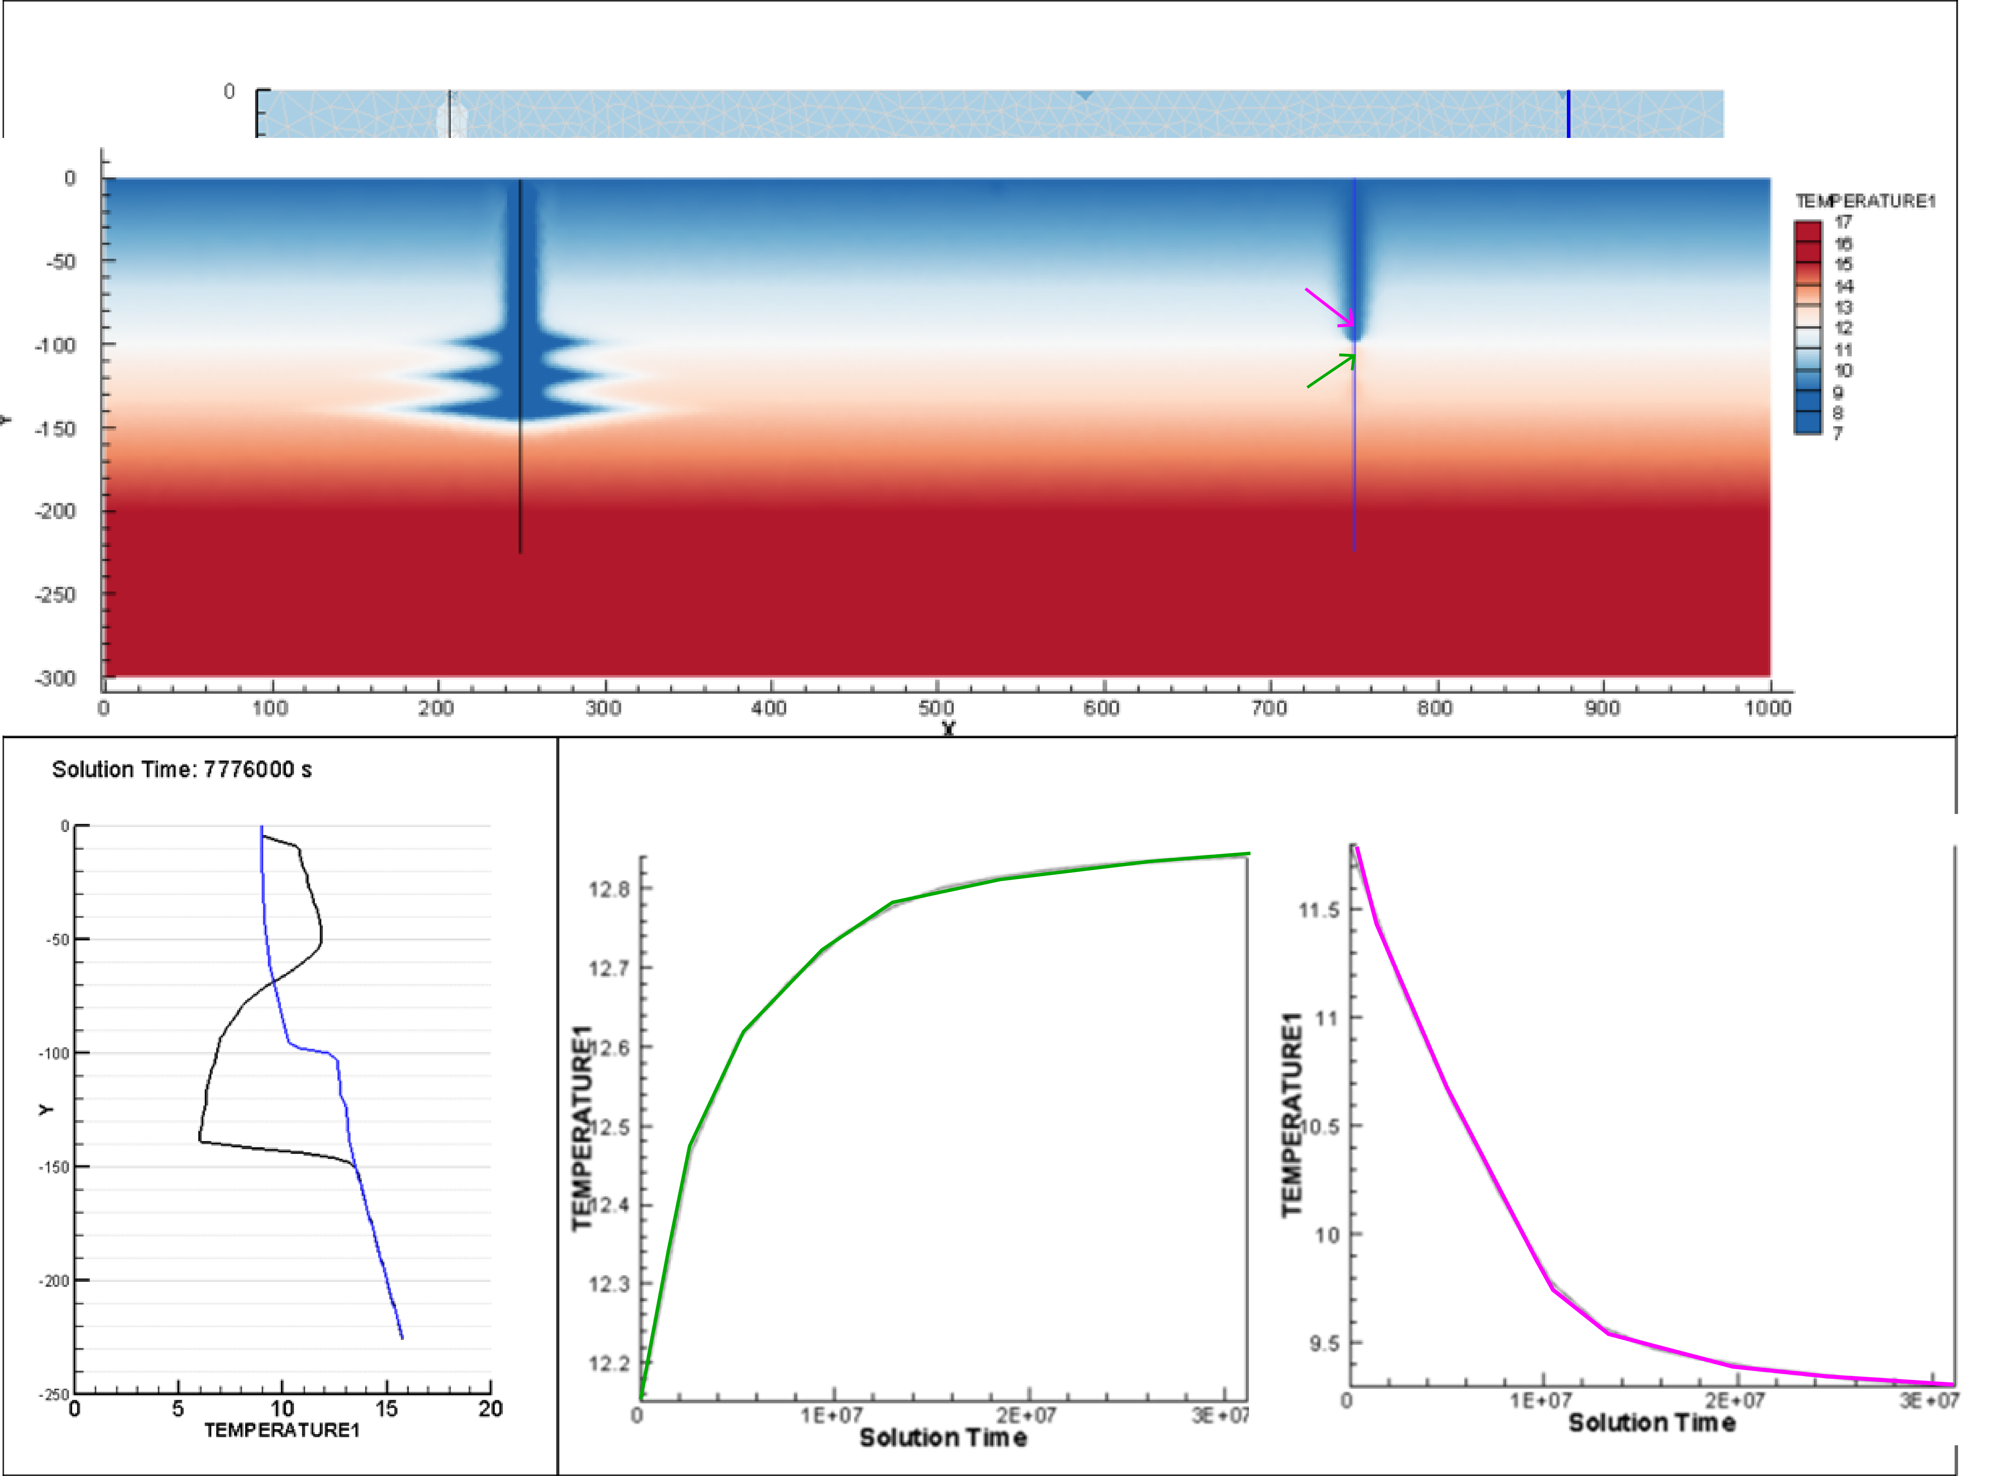
Introduction
Methods
Objectives
Conclusion
Summary
Initial results
6 degC

Slide 10
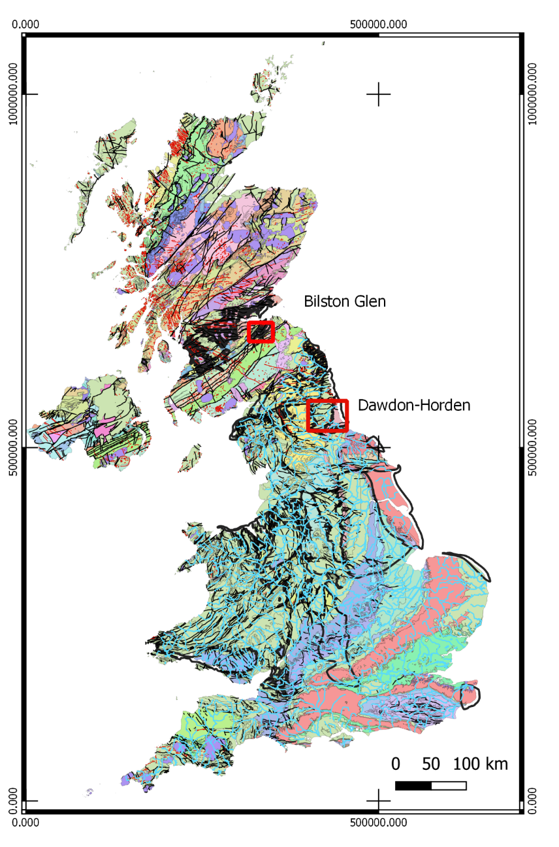
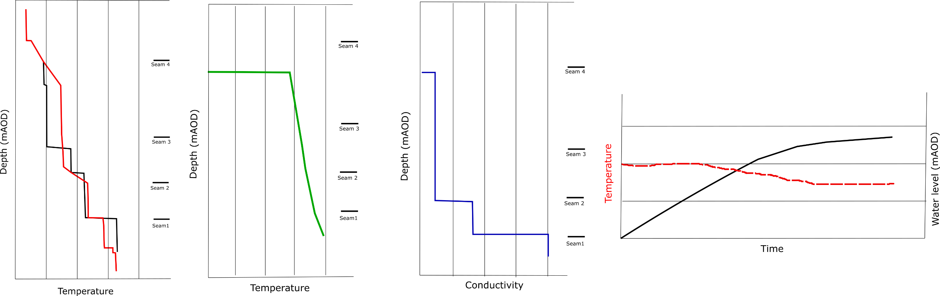
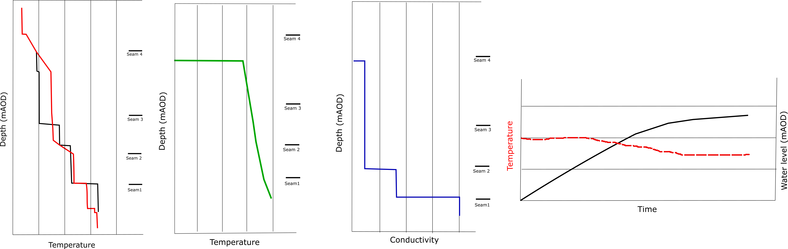
Introduction
Methods
Objectives
Conclusion
Summary
Water level / Temperature time series
Conductivity / Temperature profiles
Model calibration and validation based on existing data:
Bilston Glen (Scotland)
Dawdon (NE-England)
Check validity of heat sources contributions + geological & petro-physical properties + geometrical simplifications
Simulation of production / heat recovery
Notes:
Calibration and validation of model using existing data from Bilston Glen in Scotland - Dawdon in NE England by simulation of flooding / temperature recovery
→ Enough data and two different geometries (dipping layer / syncline)
Data types to fit: T-EC profiles and time series (water level, temperature), geochemistry (deep water in Dawdon = Chloride anion dominant = long residence time / Shallow water in Bilston Glen (Bicarbonate dominant) according to Chebotarev chart
Based on calibrated model, evaluation of the recharge rate / heat recovery rate of mine water.
→ How long can it be sustained? what is the footprint area for providing heat for domestic heating?

Slide 11
Introduction
Methods
Objectives
Conclusion
Summary
Comparison mine-water temperature data across UK with modeling results
Identification of the important features in mine plans for modeling heat transfers
What is the main control on mine-water temperature?
What is the footprint area of heat extraction?
What is the sustainability / geothermal potential of mine? → Development of a predictive tool to guide licensing of heat
Notes:
Spatial analysis of temperature distribution in the UK
Comparison between mine geometries, measurements types, the local geology and temperature at different mines will be cross correlated with results from models to answer the question:
Why different mines have different temperatures ?
Heat transfers does’t have a clear boundary
Need to guide the licensing of heat through the development a predictive tool for the Coal authority.

Slide 12
References
Adams, C., Monaghan, A., Gluyas, J., 2019. Mining for Heat. In: WWW.GEOLSOC.ORG.UK/GEOSCIENTIST
Burley, A., Edmunds M., W., and Gale, I. (1984). Catalogue of geothermal data for the land area of the United Kingdom. Second revision. British Geological Survey
Gillespie, M., Crane, E., and Barron, H. (2013). Study into the Potential for Deep Geothermal Energy in Scotland - Volume 2. AEC/001/11. Scottish Government, p. 129.
Todd, F., McDermott, C., Harris, A. F., Bond, A., and Gilfillan, S. (2019). Coupled hydraulic and mechanical model of surface uplift due to mine water rebound: implications for mine water heating and cooling schemes. Scottish Journal of Geology [online], sjg2018–028. ISSN: 0036-9276, 2041-4951. DOI: 10.1144/sjg2018-028.

Slide 13
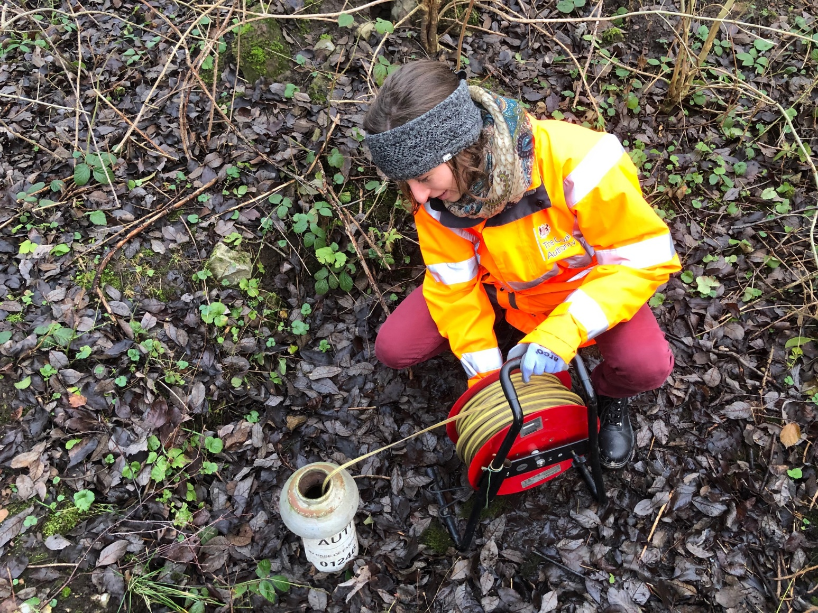
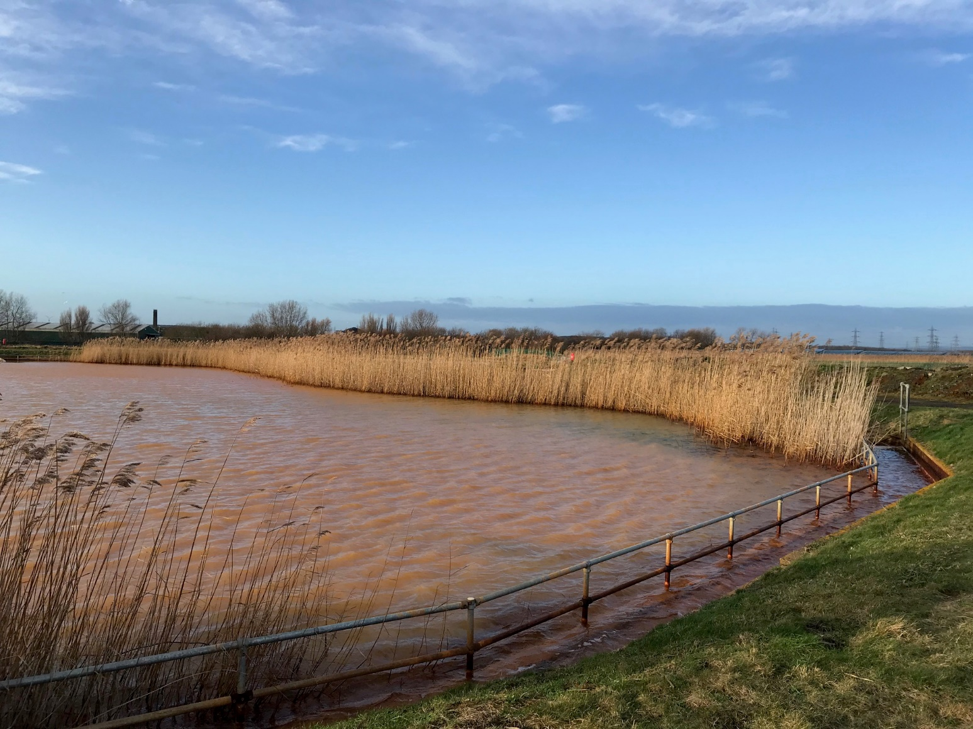
Back-up

Slide 14
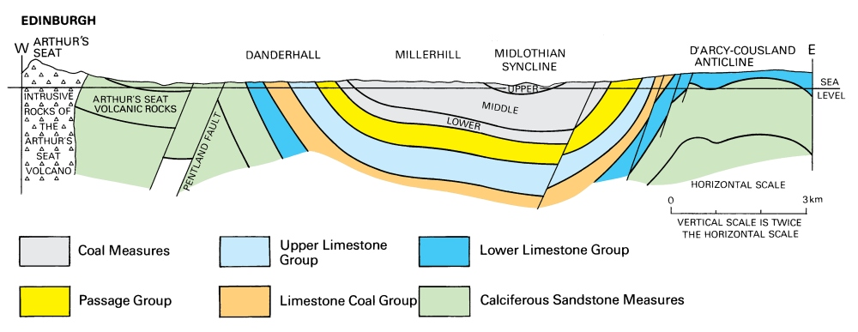
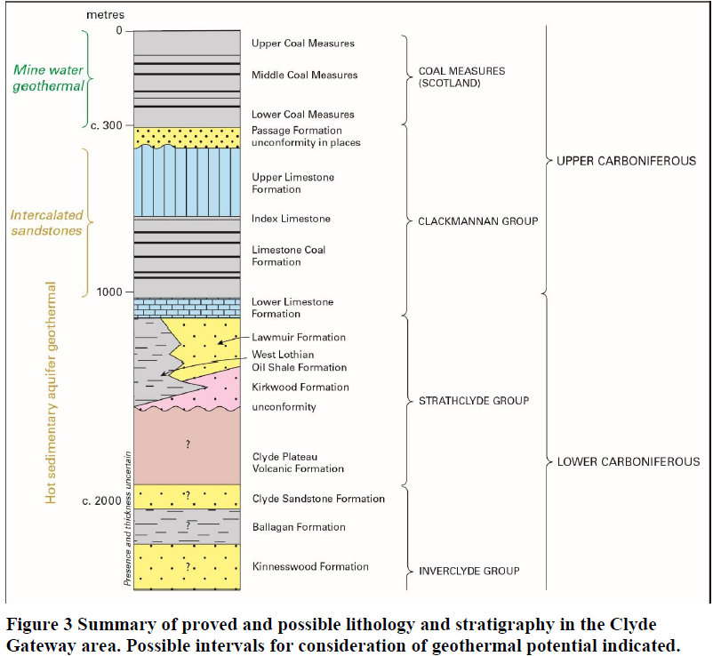
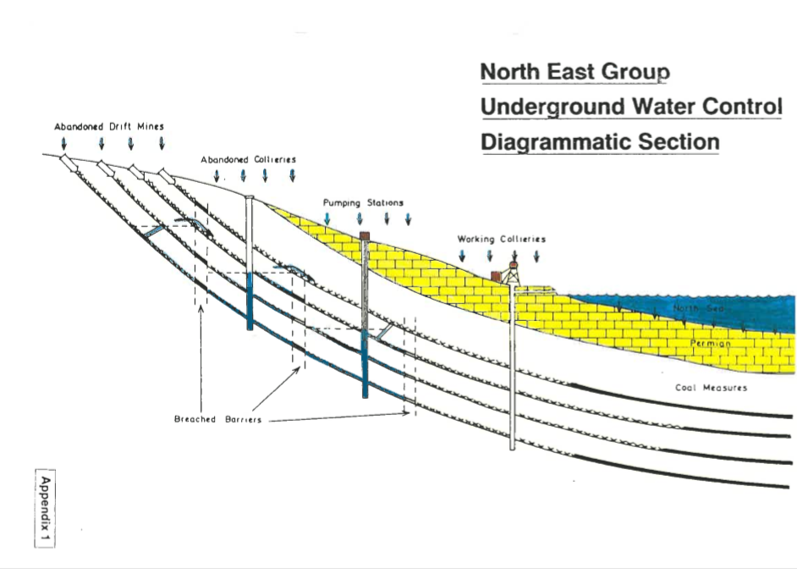
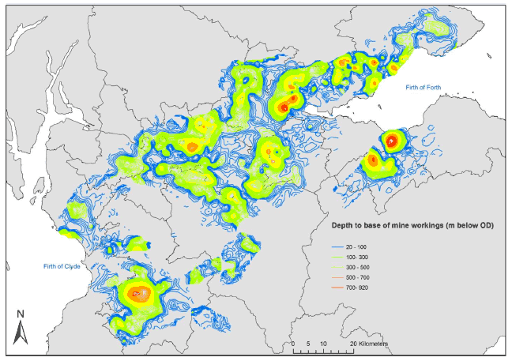
Coal Measures
Limestone Coal formation
Cross-section of the Midlothian syncline (Cameron et al., 1985)
Depth of mine workings (Gillespie et al., 2013)

Slide 15
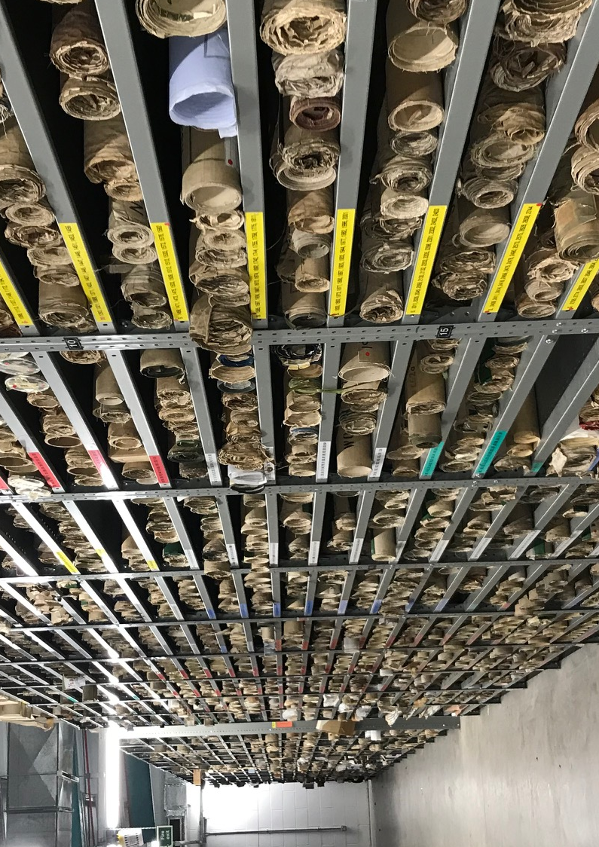
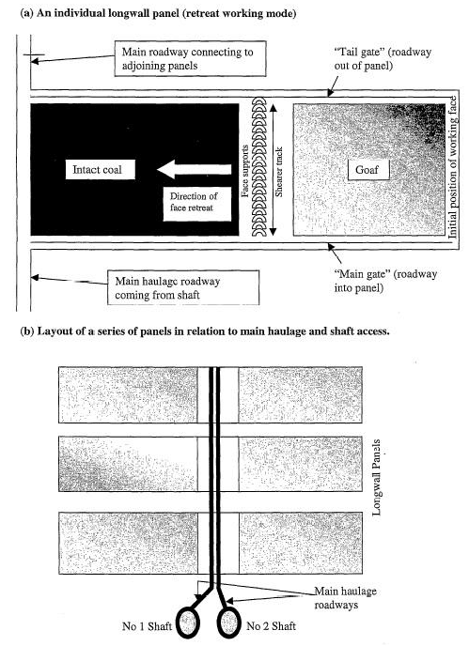
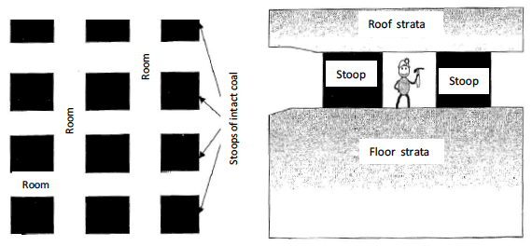
Mine systems
Introduction
Methods
Objectives
Conclusion
Summary
Mine structure
Underground workings:
Pillar and stall
Longwall mining
Main pathways :
Shafts
Roadways
Layout of stoop and room mine workings (top) and longwall mining (bottom). From Younger and Adams, 1999.
Notes:
Mining voids are a complex story.
→ 2 types of mining
Coal authority has scanned thousands of mine plans + digitalized mine plans (GIS shapefiles)

Slide 16
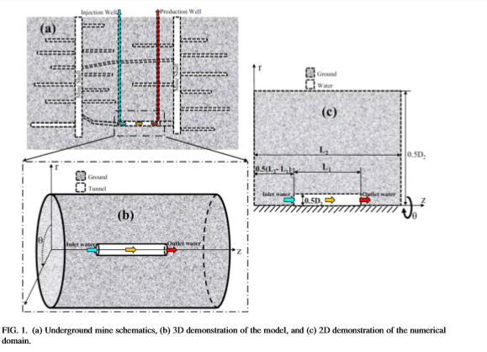
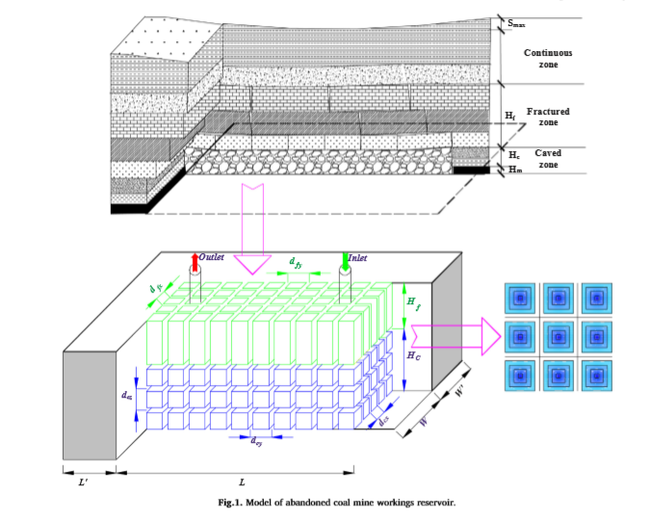
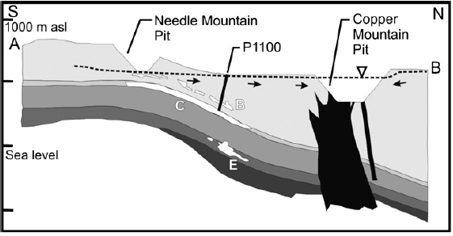
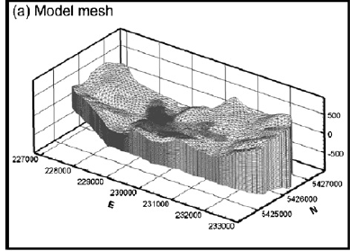
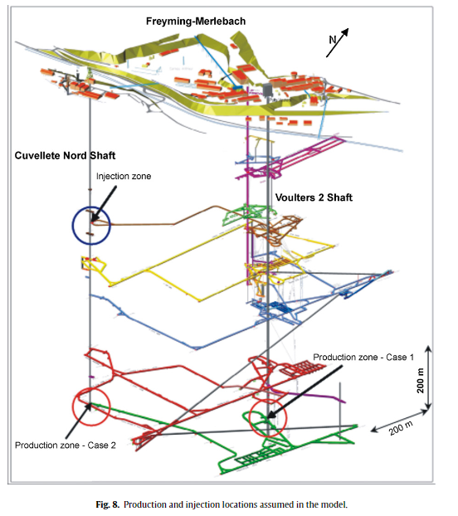
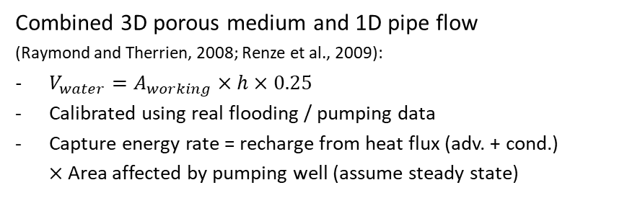
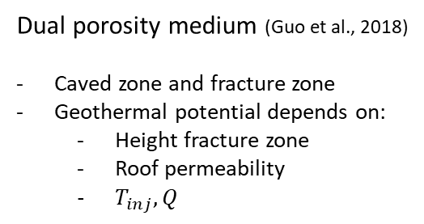
Modeling mine systems
Introduction
Methods
Objectives
Conclusion
Summary
Heat transfers in mine tunnels
(Ghoreishi Madeish et al., 2012)
Important parameters:
Thermal conductivity / Permeability
Tunnel dimension
Dual porosity medium (Guo et al., 2018)
Caved zone and fracture zone
Geothermal potential depends on:
Height fracture zone
Roof permeability
$T_{inj}, Q$
3D model of shaft/roadway connections
(Hamm et al., 2010)
Takes into account geometry of mine
Study of free convection in shafts/roadways
Assumes equivalent porous media for mine workings
Assumes thermal equilibrium rock / fluid
Density effects / K contrasts
Combined 3D porous medium and 1D pipe flow
(Raymond and Therrien, 2008; Renze et al., 2009):
$V_{water}=A_{working}$ $×h$ $×0.25$
Calibrated using real flooding / pumping data
Capture energy rate = recharge from heat flux (adv. + cond.)
$×$Area affected by pumping well (assume steady state)
Notes:
Modeling of mines done before
Both generic cases and specific case study
Both for tunnels / workings systems
Raymond and Therrien: quite complex and global modelling approach
Difficulty in mine systems (which differs from usual aquifers) is the necessity to solve for water, heat and mass transport in a system composed of a porous media (Darcy flow) and open void (pipe flow) that can lead to numerical instability. Has been overcome by combining 1D, 2D and 3D elements
But don’t evaluate the contribution of each parameter (assume all heat comes from heat flux)

Slide 17
Introduction
Methods
Objectives
Conclusion
Summary
Year 1
Year2
Year3
Conceptual modeling
Sensitivity analysis
Case study
Geometrical analysis
Geothermal potential evaluation
Cross-correlated spatial VS temperature analysis
Development of a predictive (conceptual or numerical) tool.
Recommendation on a scientific approach to guide the licensing of heat
Support the dimensioning of GSHP systems

Slide 18
References
Andrés, C., Ordóñez, A., and Álvarez, R. (2017). Hydraulic and Thermal Modelling of an Underground Mining Reservoir. Mine Water and the Environment [online]. 36.1, pp. 24–33. ISSN: 1025-9112, 1616-1068. DOI: 10.1007/s10230-015-0365-1.
Burley, A., Edmunds M., W., and Gale, I. (1984). Catalogue of geothermal data for the land area of the United Kingdom. Second revision. British Geological Survey
Gillespie, M., Crane, E., and Barron, H. (2013). Study into the Potential for Deep Geothermal Energy in Scotland - Volume 2. AEC/001/11. Scottish Government, p. 129.
Ghoreishi-Madiseh, S. A., Ghomshei, M. M., Hassani, F. P., and Abbasy, F. (2012). Sustainable heat extraction from abandoned mine tunnels: A numerical model. J. Renewable Sustainable Energy, p. 17.
Hamm, V. and Bazargan Sabet, B. (2010). Modelling of fluid flow and heat transfer to assess the geothermal potential of a flooded coal mine in Lorraine, France. Geothermics [online]. 39, pp. 177–186. DOI: 10.1016/ j.geothermics.2010.03.004.
Raymond, J. and Therrien, R. (2008). Low-temperature geothermal potential of the flooded Gaspé Mines, Québec, Canada. Geothermics [online]. 37.2, pp. 189–210. ISSN: 03756505. DOI: 10.1016/j.geothermics.2007.10.001.
Renz, A., Rühaak, W., Schätzl, P., and Diersch, H.-J. G. (2009). Numerical Modeling of Geothermal Use of Mine Water: Challenges and Examples. Mine Water and the Environment [online]. 28.1, pp. 2–14. ISSN: 1025-9112, 1616-1068. DOI: 10.1007/s10230-008-0063-3.
Todd, F., McDermott, C., Harris, A. F., Bond, A., and Gilfillan, S. (2019). Coupled hydraulic and mechanical model of surface uplift due to mine water rebound: implications for mine water heating and cooling schemes. Scottish Journal of Geology [online], sjg2018–028. ISSN: 0036-9276, 2041-4951. DOI: 10.1144/sjg2018-028.
Younger, P. L. (2004). Making water: the hydrogeological adventures of Britain in early mining engineers. Geological Society, London, Special Publications [online]. 225.1, pp. 121–157. ISSN: 0305-8719, 2041-4927. DOI: 10.1144/GSL.SP.2004.225.01.09.

